Slide 1
DBT Fundamentals

Slide 2
DBT Fundamentals Structure of this Course
Traditional Data Teams
ETL and ELT
Role of Analytical Engineer and Modern Data Team
How DBT fits into modern data stack
Version Control
Basic Commands
What are models
Ref Function
Naming Conventions
Materialization in DBT
Jinja
Macros
Set Variable

Slide 3
Traditional Data Teams
Data engineers are responsible for maintaining data infrastructure and the ETL process for creating tables and views
Data analysts focus on querying tables and views to drive business insights for stakeholders.

Slide 4
ETL AND ELT
ETL (extract transform load) is the process of creating new database objects by extracting data from multiple data sources, transforming it on a local or third party machine, and loading the transformed data into a data warehouse.
DBT : It empowers data teams to leverage software engineering principles for transforming data.
There are two ways we can effectively use DBT
1. DBT Core : is a command line tool that can be run locally.
2. DBT Cloud CLI and IDE : is a hosted version that streamlines development with an online Integrated Development Environment (IDE) and an interface to run dbt on a schedule.

Slide 5
Version Control
dbt also enables developers to leverage a version control system to manage their code base. A popular version control system is git.
dbt is going to be the transformation interface between the code we write (stored and managed in a git repository) and the sample data we have to work with (stored and transformed in your data platform).

Slide 6
Basic Commands
Dbt debug
DBT seed
Dbt compile
Dbt run
Dbt build
Dbt Surrogate_key
Dbt Test
Docs block
Dbt-source_freshness
Dbt full-refresh
Dbt incremental
DBT snapshot
Dbt docs generate
Dbt docs serve
Dbt Exclude

Slide 7
DBT Debug
dbt debug is a utility function to test the database connection and display information for debugging purposes, such as the
validity of your project file and your installation of any requisite dependencies (like git).
Show the configured location for the profiles.yml file and exit:
Dbt debug –config-dir

Slide 8
DBT Seed
Seeds are CSV files in your dbt project (typically in your seeds directory), that dbt can load into your data warehouse using the dbt seed command.
Because these CSV files are located in your dbt repository, they are version controlled and code reviewable. Seeds are best suited to static data which changes infrequently.

Slide 9
DBT Compile
DBT Compile: (add screen shot)
DBT compile generates executable SQL from source model, test, and analysis files. You can find these compiled SQL files in the target/ directory of your dbt project.
It doesn't materialize the model's compiled SQL into an existing table.

Slide 10
DBT RUN AND BUILD
DBT RUN : Executes compiled sql model files against the current target database. dbt connects to the target database and runs the relevant SQL required to materialize all
data models using the specified materialization strategies. Models are run in the order defined by the dependency graph generated during compilation.
The dbt build command will:
run models
test tests
snapshot snapshots
seed seeds

Slide 11
Surrogate Key
A surrogate key is a hashed value of multiple fields in a dataset that create a uniqueness constraint on that dataset

Slide 12
DBT Test
dbt test runs tests defined on models, sources, snapshots, and seeds. It expects that you have already created those resources through the appropriate commands.
The tests to run can be selected using the --select flag
dbt test –select one_model
Dbt test –select sample_package.* (all the models in the package)
Dbt test –select test_type:singular
Dbt test –select test_type:generic
Dbt test –select one_model,tets_type:generic
Dbt test –select one_nodel,test_type:singular

Slide 13
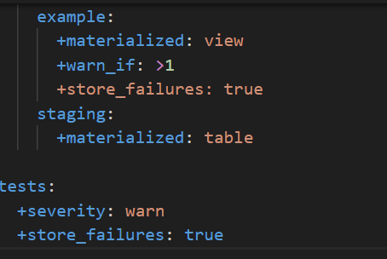
Test Severity
If severity: error, dbt will check the error_if condition first. If the error condition is met, the test returns an error. If it's not met, dbt will then check the warn_if condition (defaulted to !=0). If it's not specified or the warn condition is met, the test warns; if it's not met, the test passes.
If severity: warn, dbt will skip the error_if condition entirely and jump straight to the warn_if condition. If the warn condition is met, the test warns; if it's not met, the test passes.

Slide 14
Test Store failures
dbt test --store-failures
When true, store_failures save all the record(s) that failed the test only if limit is not set or if there are fewer records than the limit. store_failures are saved in a new table with the name of the test. By default, store_failures use a schema named dbt_test__audit, but, you can configure the schema to a different value.

Slide 15
Artifacts and Skip on failures
Artifacts: The build task will write a single manifest and a single run results artifact. The run results will include information about all models, tests, seeds, and snapshots that were selected to build, combined into one file.
Skip On Failures: Tests on upstream resources will block downstream resources from running, and a test failure will cause those downstream resources to skip entirely. E.g. If model_b depends on model_a, and a unique test on model_a fails, then model_b will SKIP.
Don't want a test to cause skipping? Adjust its severity or thresholds to warn instead of error
In the case of a test with multiple parents, where one parent depends on the other (e.g. a relationships test between model_a + model_b), that test will block-and-skip children of the most-downstream parent only (model_b).

Slide 16

Docs Block
The doc function is used to reference docs blocks in the description field of schema.yml files. It is analogous to the ref function
{% docs status %}
One of the following values:
| status | definition |
|----------------|--------------------------------------------------|
| placed | Order placed, not yet shipped |
| shipped | Order has been shipped, not yet been delivered |
| completed | Order has been received by customers |
| return pending | Customer indicated they want to return this item |
| returned | Item has been returned |
{% enddocs %}

Slide 17
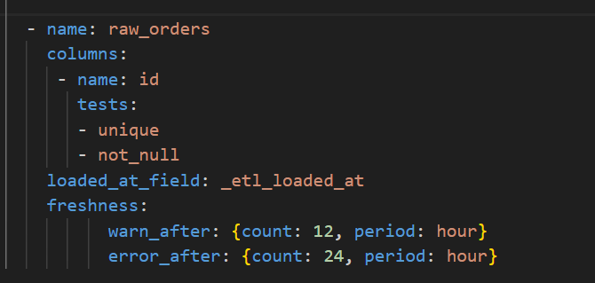
DBT Source Freshness
dbt source freshness is a dbt command to test whether your source tables have been updated within a desired frequency. dbt source freshness tests work are configured using a field named 'loaded_at_field'. This is a timestamp column you wish to use to check freshness.

Slide 18
Models
Models
Models are .sql files that live in the models folder.
Models are simply written as select statements - there is no DDL/DML that needs to be written around this. This allows the developer to focus on the logic.
After constructing a model, dbt run in the command line will actually materialize the models into the data warehouse. The default materialization is a view

Slide 19
Ref function
Models can be written to reference the underlying tables and views that were building the data warehouse (e.g. public.stg_customers). This hard codes the table names and makes it difficult to share code between developers.
The ref function allows us to build dependencies between models in a flexible way that can be shared in a common code base. The ref function compiles to the name of the database object as it has been created on the most recent execution of dbt run in the particular development environment.
Example: {{ ref('stg_customers') }} compiles to public.stg_customers.
The ref function also builds a lineage graph

Slide 20
Naming Conventions
Sources (src) refer to the raw table data that have been built in the warehouse
Staging (stg) refers to models that are built directly on top of sources. These have a one-to-one relationship with sources tables.
Lightweight Transformations
They are used to clean the data and standardize it before downstream
Intermediate (int) refers to any models that exist between final fact and dimension tables.
The Fact and Dimension convention is based on previous normalized modeling techniques.

Slide 21
Materilaizations
Materializations are strategies for persisting dbt models in a warehouse. There are five types of materializations built into dbt. They are:
table
View
incremental
ephemeral
materialized view

Slide 22
Materialization in DBT
View : When using the view materialization, your model is rebuilt as a view on each run, via a create view as statement.
Table: When using the table materialization, your model is rebuilt as a table on each run, via a create table as statement.
incremental models allow dbt to insert or update records into a table since the last time that model was run.
Ephemeral:
ephemeral models are not directly built into the database. Instead, dbt will interpolate the code from this model into dependent models as a common table expression.
Materialized view: The materialized view materialization allows the creation and maintenance of materialized views in the target database. This materialization makes use of the on_configuration_change config, which aligns with the incremental nature of the namesake database object.
Python materializations​
Python models support two materializations:
table
incremental

Slide 23
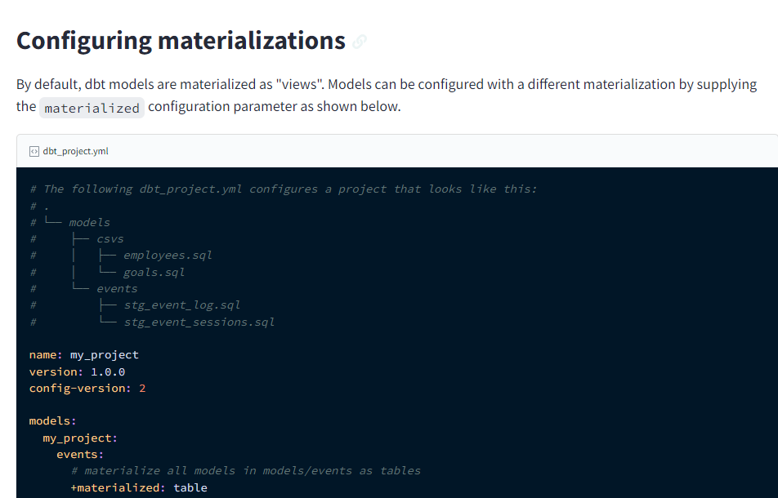
Materialization in dbt_project.yml

Slide 24
Materialization in model file

Slide 25
Incremental Models
Incremental models are built as tables in your data warehouse. The first time a model is run, the table is built by transforming all rows of source data. On subsequent runs, dbt transforms only the rows in your source data that you tell dbt to filter for, inserting them into the target table which is the table that has already been built.
Incremental Model filtering we can do on date and as well we can maintain unique key in the incremental model
first time we maintain only the filter and second time we change the value of the old record by maintaining unique key
So, here second time we change the logic of the incremental model.. We need to run the incremental in full refresh by denoting + after the model name. So that (upstream models are getting built using that logic) as well the old records are getting updated to the new logic of the incremental model
(to implement incremental …with scd type 2)

Slide 26
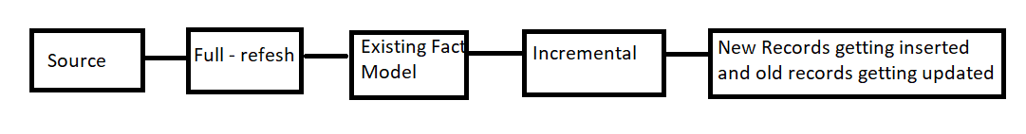
Incremental Model

Slide 27
Facts and Dimensions
Facts​
A dimensional model represents the different business processes of an organization. A fact table with its dimension table is a single business process. Each dimensional model consists of many fact tables, with each fact table joined with corresponding dimension tables.
A fact table or a fact entity is a table or entity in a star or snowflake schema that stores measures that measure the business, such as sales, cost of goods, or profit. Fact tables and entities aggregate measures , or the numerical data of a business.
if you have a shop or supermarket, you will use the transaction fact table to record each transaction happened over the day, if you have 100 customers purchased over the day, you will have 100 records at transaction fact table

Slide 28
Facts and Dimensions
Pre-cloud data warehouses, there were two dominant design options, star schemas and snowflake schemas, that were used to concretely separate out the lines between fact and dimension tables.
In a star schema, there’s one central fact table that can join to relevant dimension tables.
A snowflake schema is simply an extension of a star schema; dimension tables link to other dimension tables making it form a snowflake-esque shape.
Fact tables hold numerical data, whereas dimension tables provide descriptive context to the information stored in fact tables. When tackling queries related to 'what' and 'how much,' refer to the fact table. For insights into 'who,' 'where,' 'when,' and 'why,' turn to the dimension table

Slide 29
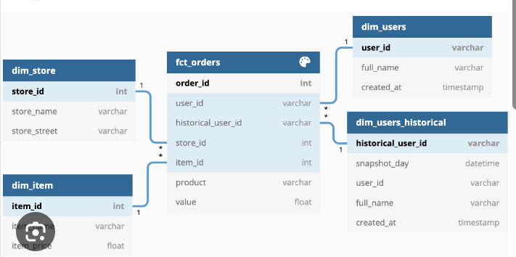
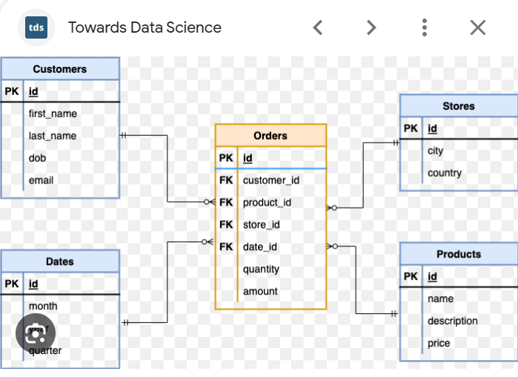
Facts and Dimensions

Slide 30
Ephemeral Model
Ephemeral​
ephemeral models are not directly built into the database. Instead, dbt will interpolate the code from this model into dependent models as a common table expression.

Slide 31
SCD (SLOWLY CHANGING DIMENSION)
SCDs are considered and implemented as one of the most critical ETL/ELT tasks in tracking the history of dimension records. For example, if we have a fact and dimension tables, the fact table is linked to the dimension tables with the help of foreign keys. If any of the dimension table data changes, we have to keep track of the data changes for reporting purposes.

Slide 32
SCD – TYPE 0
Type-0
Simple and no special action is required.
This type is pretty simple and doesn’t require any special action since type 0-dimensional table has the static data, the values remain the same forever.
Example – Date dimension table (static data)
Date | day | week_in_a_month | week_in_a_year
2021-01-18 | Monday | 4th week | 4th week
2021-02-18 | Thursday | 3rd week | 8th week

Slide 33
SCD – TYPE 1
Type-1
Insert and overwrite (upsert).
In this type, all the brand new records will get inserted and any change to the existing record will overwrite the old value with a new one. No history data is maintained in this type.
Before the change:
Emp_id | Emp_name | state
1111 | Tom | MI
1212 | Adam | MN

Slide 34
Type -1
After the change:
Emp_id | Emp_name | state
1111 | Tom | AZ | Exisiting record, so overwritten the old value
1212 | Adam | MN
1818 | Frank | NY | New record, so inserted

Slide 35
Type -2
Type-2
Insert a changed record.
In this type, insert all brand new records and all changed records will terminate with the end_date and set the current_flag_status to false. Create a new record for changed data values with open end_date and set the current_flag_status to true.
Each and every record has the effective date, end date, and flag status fields to identify in which time period the record was active.

Slide 36
Before and After change
Emp_id | Emp_name | state | Effective_date | end_date | current_flag_status
1111 | Tom | MI | 2020-10-08 | 9999-12-31 | True
1212 | Adam | MN | 2020-10-08 | 9999-12-31 | True
Emp_id | Emp_name | state | Effective_date | end_date | current_flag_status
1111 | Tom | MI | 2020-10-08 | 2021-10-09 | False | Old record terminated
1111 | Tom | AZ | 2020-10-09 | 9999-12-31 | True
1212 | Adam | MN | 2020-10-08 | 9999-12-31 | True

Slide 37
Type 3
Store the new and old values in current and previous fields.
In this method, we usually have current and previous value fields. The new value is ingested into the current field and the old value is ingested into Previous field.
Emp_id | Emp_name | current_state | Previous_state
1111 | Tom | MI | MI
1212 | Adam | MN | MN
Emp_id | Emp_name | current_state | Previous_state
1111 | Tom | AZ | MI
1212 | Adam | MN | MN

Slide 38
Type-4
Maintain data in separate tables (current table, history table).
In this method, we will maintain the data in two separate tables. All the current active data will be seen in the current table and all the history data will be seen in the history table with the effective and end date fields to determine in which time period the record was active.
Emp_id | Emp_name | state
1111 | Tom | AZ
Current table:
History table:
Emp_id | Emp_name | state | Effective_date | end_date
1111 | Tom | MI

Slide 39
Type-6
Type 1 + Type 2 + Type 3 (Combined approach).
This method is a combination of Type 1 (insert and overwrite), Type 2 (insert a changed record), and Type 3 (store the new and old values in current and previous fields) approaches.

Slide 40
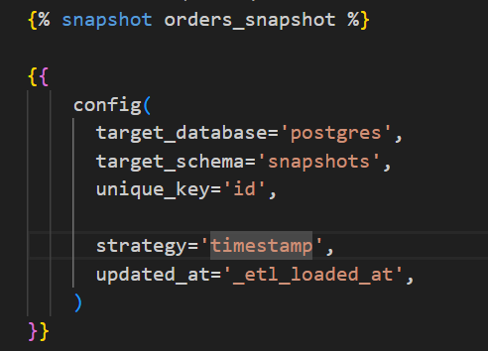
DBT Snapshots
Snapshots implement type-2 Slowly Changing Dimensions over mutable source tables. These Slowly Changing Dimensions (or SCDs) identify how a row in a table changes over time.
On the first run: dbt will create the initial snapshot table — this will be the result set of your select statement, with additional columns including dbt_valid_from and dbt_valid_to. All records will have a dbt_valid_to = null
On subsequent runs: dbt will check which records have changed or if any new records have been created:
The dbt_valid_to column will be updated for any existing records that have changed
The updated record and any new records will be inserted into the snapshot table. These records will now have dbt_valid_to = null
dbt_scd_id : A unique key generated for each snapshotted record.
dbt_updated_at : The updated_at timestamp of the source record when this snapshot row was inserted.

Slide 41
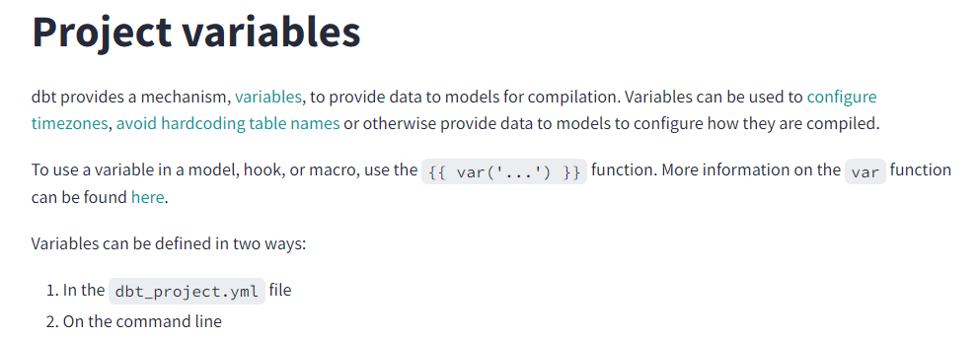
Variables

Slide 42
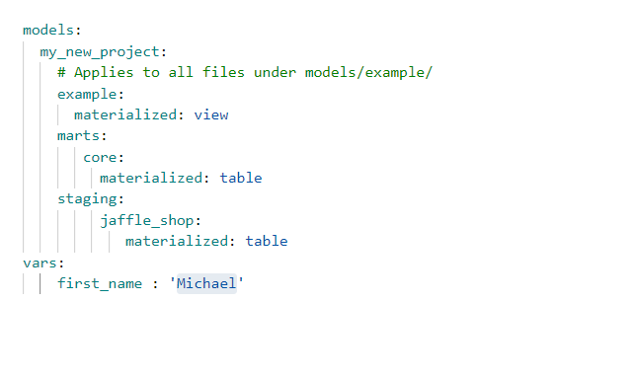
Config of variables in dbt_project.yml

Slide 43
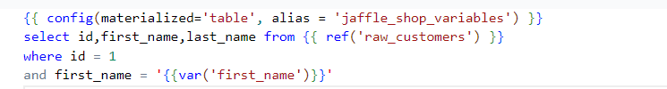

Config in the model
dbt build -s example_variables --vars '{"first_name": "var('first_name')"}'

Slide 44

Jinja
Using Jinja turns your dbt project into a programming environment for SQL, giving you the ability to do things that aren't normally possible in SQL. For example, with Jinja you can:
Use control structures (e.g. if statements and for loops) in SQL
Use environment variables in your dbt project for production deployments
Change the way your project builds based on the current target.
{{ ref() }} function, jinja u have used
Expressions {{ ... }}: Expressions are used when you want to output a string
Statements {% ... %}: Statements are used for control flow, for example, to set up for loops and if statements, or to define macros.
Comments {# ... #}: Jinja comments are used to prevent the text within the comment from compiling.
{# {{ cents_to_dollars('amount') }} as amount_usd #}
Look at the Complied sql to view your jijna sql
dbt compile in dbt core (target/compiled/{project name}/) you can see the
Jinja sql in this compiled folder
docs blocks, snapshots, and materializations are custom Jinja blocks that exist only in dbt.

Slide 45
Set Variable
{% set ... %} can be used to create a new variable, or update an existing one. We recommend setting variables at the top of a model, rather than hardcoding it inline
In this project we have used set variable in jinja code for payments method

Slide 46
Macros
Macros in Jinja are pieces of code that can be reused multiple times – they are analogous to "functions" in other programming languages, and are extremely useful if you find yourself repeating code across multiple models. Macros are defined in .sql files, typically in your macros directory (docs).

Slide 47
DBT DOCS GENERATE and DBT DOCS SERVE
The command is responsible for generating your project's documentation website by
Copying the website index.html file into the target/ directory
Compiling the resources in your project, so that their compiled_code will be included in manifest.json
Running queries against database metadata to produce the catalog.json file, which contains metadata about the tables and views produced by the models in your project.
DBT DOCS SERVE
This command starts a webserver on port 8080 to serve your documentation locally and opens the documentation site in your default browser

Slide 48
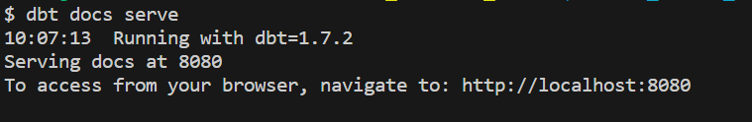
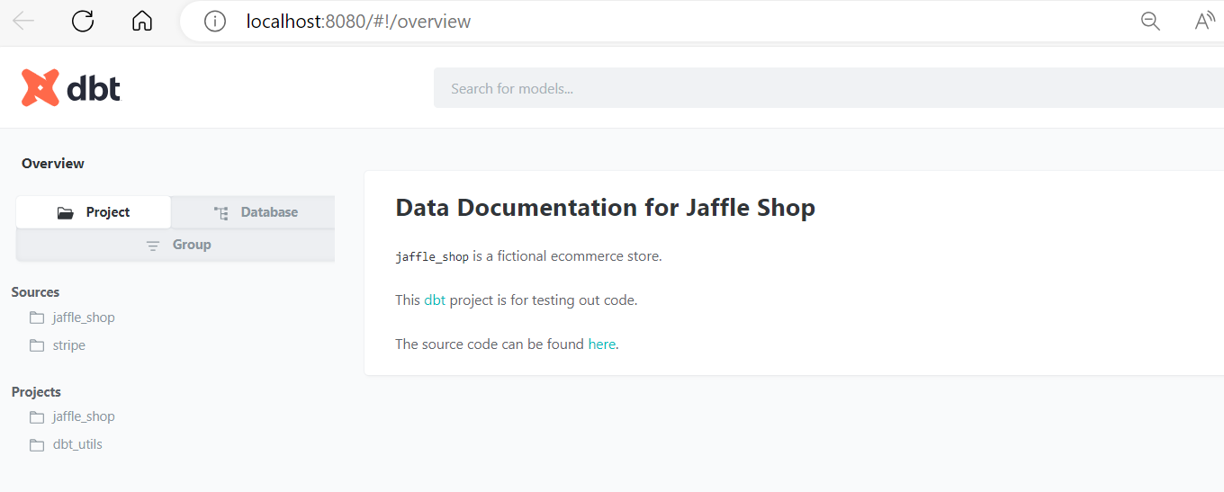
DBT DOCS SERVE DISPLAY

Slide 49
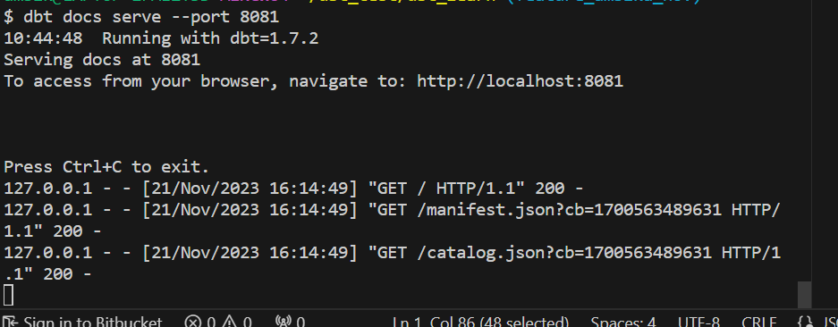
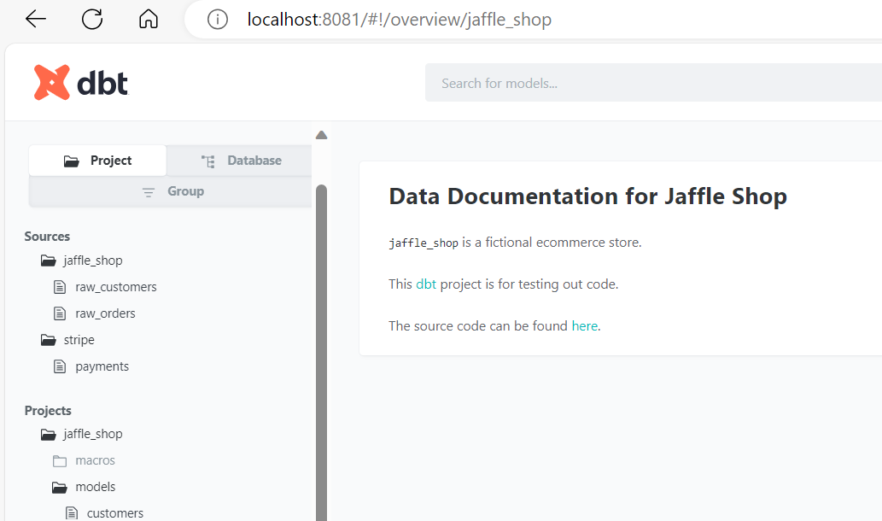
Docs Serve with –port

Slide 50
DBT Exclude
dbt provides an --exclude flag with the same semantics as --select. Models specified with the --exclude flag will be removed from the set of models selected with --select.
Dbt exclude –select model_name
This command is going to remove stg_orders from the test

Slide 51
Post Hook and Pre hook

Slide 52
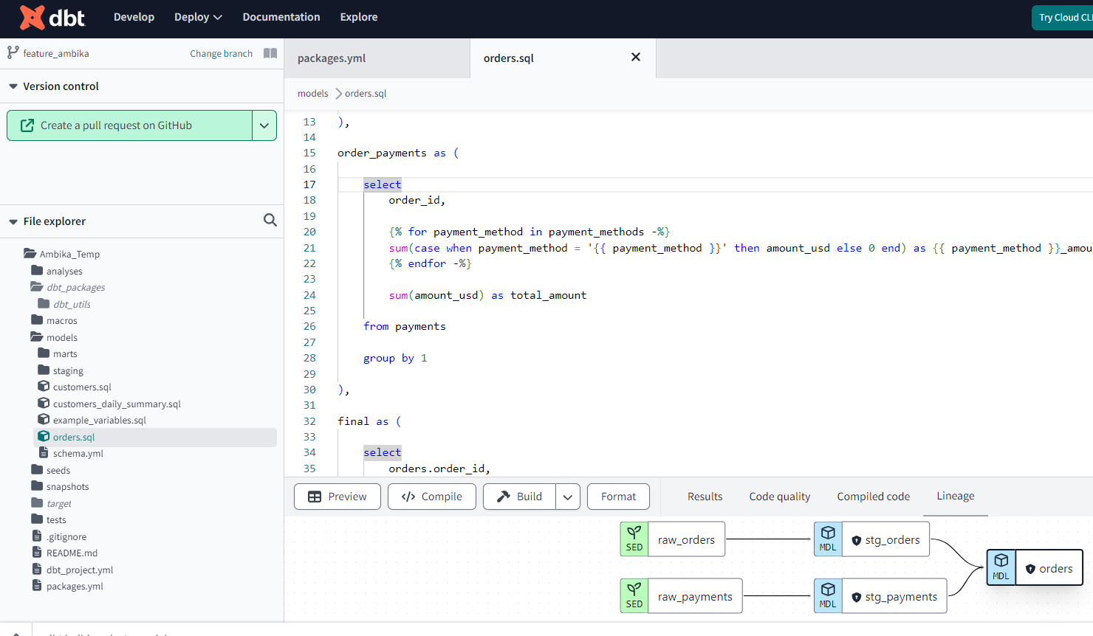
DBT Cloud IDE
The dbt Cloud integrated development environment (IDE) is a single interface for building, testing, running, and version-controlling dbt projects from your browser. With the Cloud IDE, you can compile dbt code into SQL and run it against your database directly

Slide 53
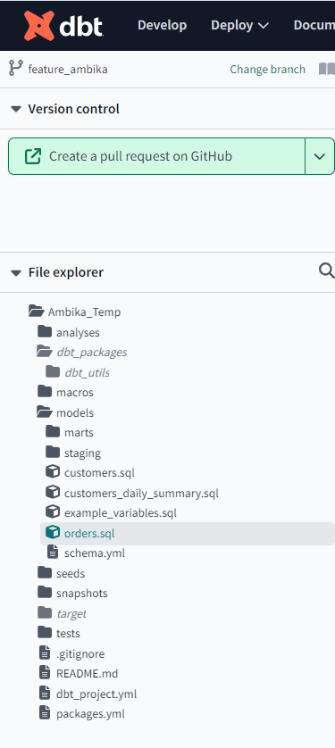
Basic Layout of DBT
The IDE streamlines your workflow, and features a popular user interface layout with files and folders on the left, editor on the right, and command and console information at the bottom.
Git repository link — Clicking the Git repository link, located on the upper left of the IDE, takes you to your repository on the same active branch.
2. Documentation site button — Clicking the Documentation site book icon, located next to the Git repository link, leads to the dbt Documentation site. The site is powered by the latest dbt artifacts generated in the IDE using the dbt docs generate command from the Command bar.

Slide 54
Basic Layout of DBT
Version Control — The IDE's powerful Version Control section contains all git-related elements, including the Git actions button and the Changes section.
File Explorer — The File Explorer shows the filetree of your repository. You can:
Click on any file in the filetree to open the file in the File Editor.
Click and drag files between directories to move files.
Right click a file to access the sub-menu options like duplicate file, copy file name, copy as ref, rename, delete.
Note: To perform these actions, the user must not be in read-only mode, which generally happens when the user is viewing the default branc

Slide 55
Basic Layout of DBT
Use file indicators, located to the right of your files or folder name, to see when changes or actions were made:
Unsaved (•) — The IDE detects unsaved changes to your file/folder
Modification (M) — The IDE detects a modification of existing files/folders
Added (A) — The IDE detects added files
Deleted (D) — The IDE detects deleted files

Slide 56
Command Bar
Command bar — The Command bar, located in the lower left of the IDE, is used to invoke dbt commands. When a command is invoked, the associated logs are shown in the Invocation History Drawer.
IDE Status button — The IDE Status button, located on the lower right of the IDE, displays the current IDE status. If there is an error in the status or in the dbt code that stops the project from parsing, the button will turn red and display "Error". If there aren't any errors, the button will display a green "Ready" status. To access the IDE Status modal, simply click on this button.

Slide 57
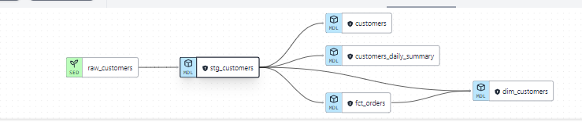
Data Lineage Graph

Slide 58
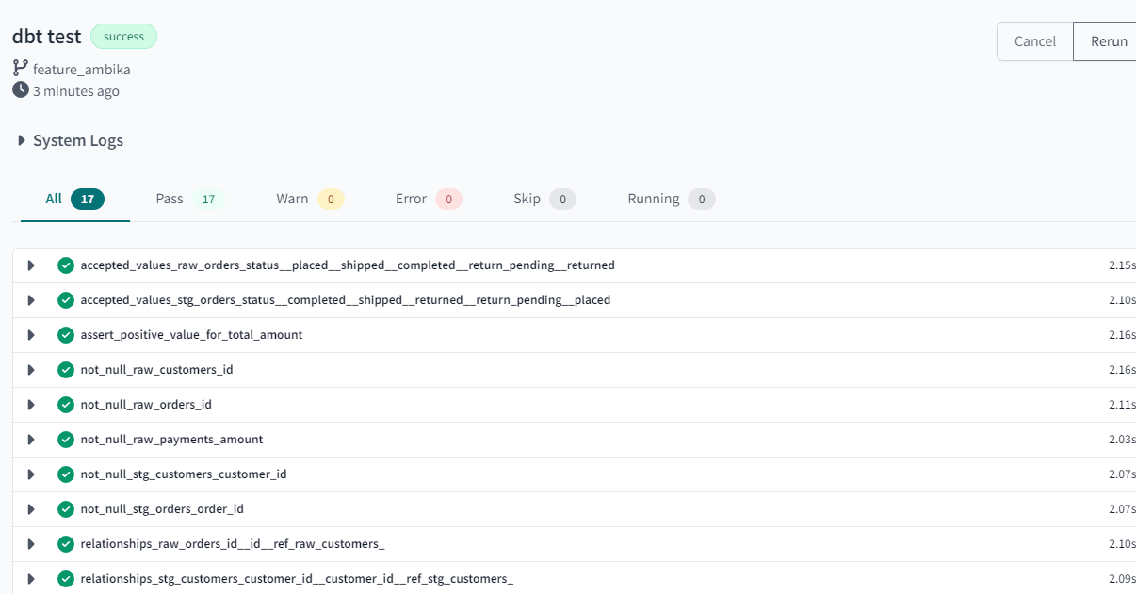
DBT Test in cloud

Slide 59
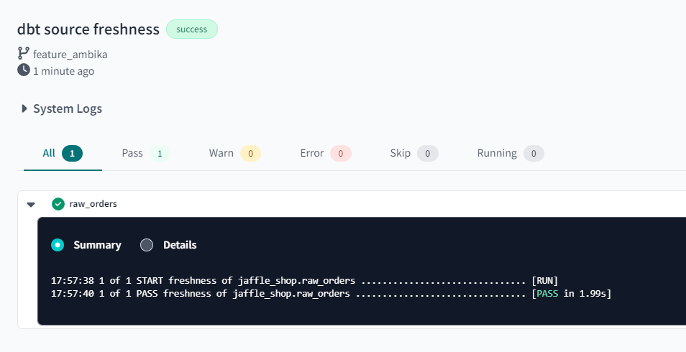
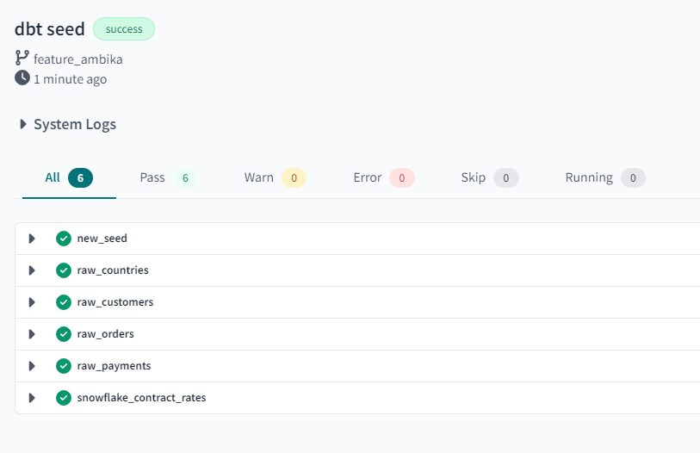
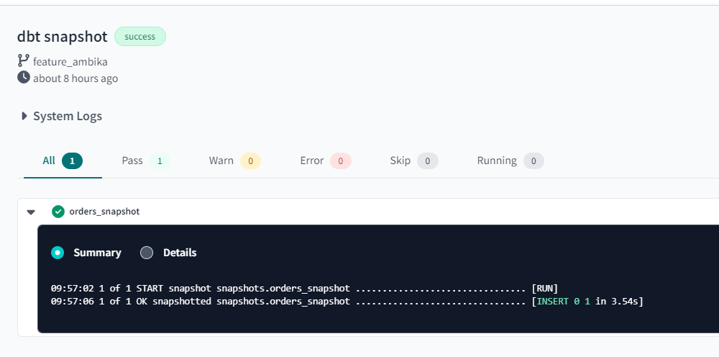
Screen shots of Below Commands

Slide 60
Output of snapshot table

Slide 61
What is Deployment and Slim CI jobs
Use dbt Cloud's capabilities to seamlessly run a dbt job in production or staging environments. Rather than run dbt commands manually from the command line, you can leverage the dbt Cloud's in-app scheduling to automate how and when you execute dbt.
Merits of Deployment:
Keep production data fresh on a timely basis
Ensure CI and production pipelines are efficient
Identify the root cause of failures in deployment environments
Maintain high-quality code and data in production
Gain visibility into the health of deployment jobs, models, and tests

Slide 62
Slim CI Job
You can set up continuous integration (CI) jobs to run when someone opens a new pull request (PR) in your dbt Git repository. By running and testing only modified models, dbt Cloud ensures these jobs are as efficient.
Commands — By default, it includes the dbt build --select state:modified+ command. This informs dbt Cloud to build only new or changed models and their downstream dependents. Importantly, state comparison can only happen when there is a deferred environment selected to compare state to.

Slide 63
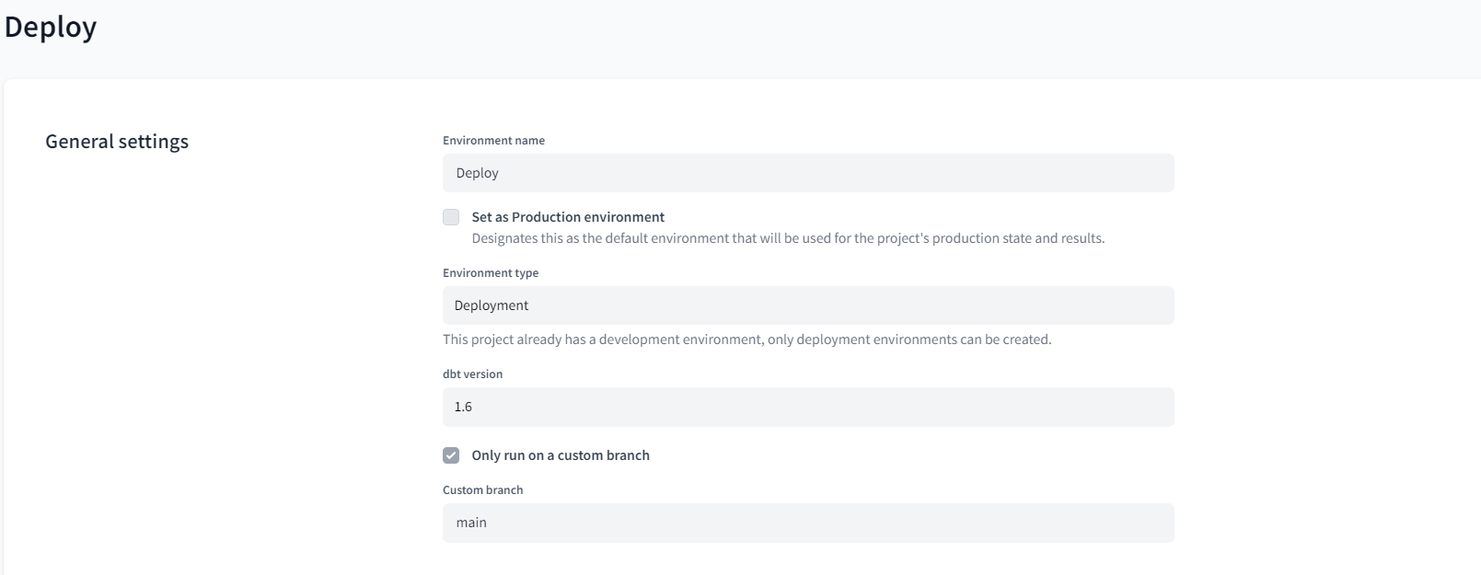
Deployment Environment settings

Slide 64
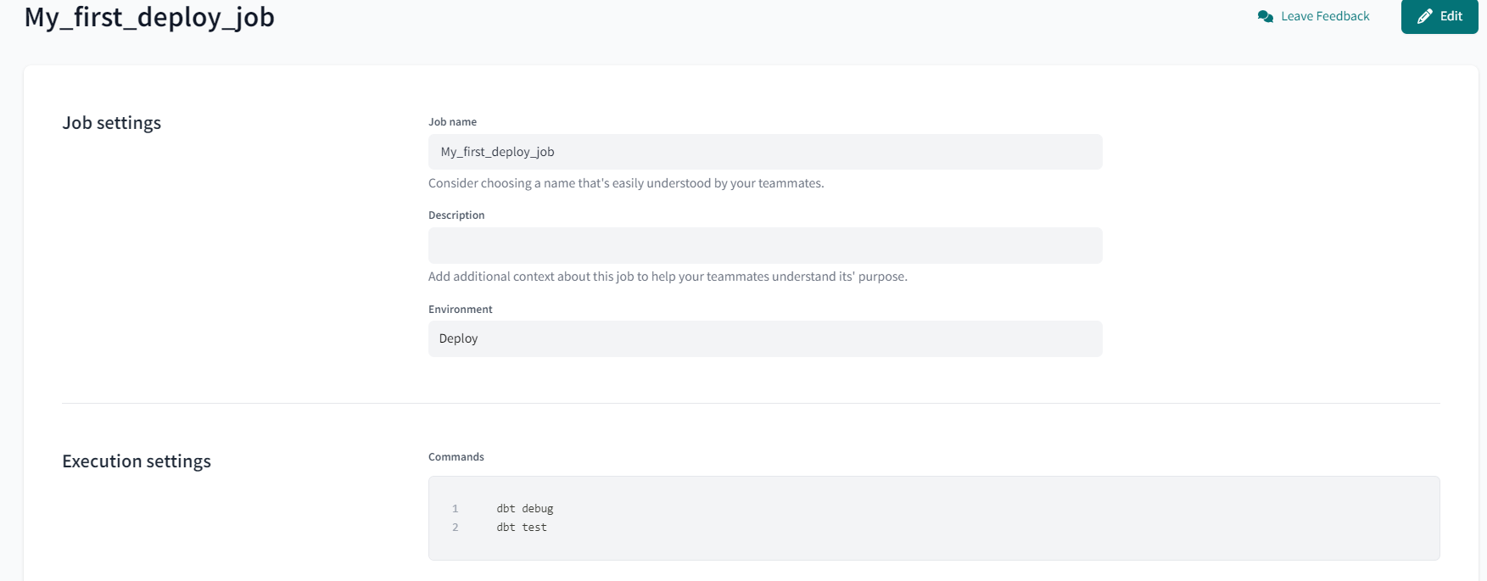
Deploy Job Settings

Slide 65
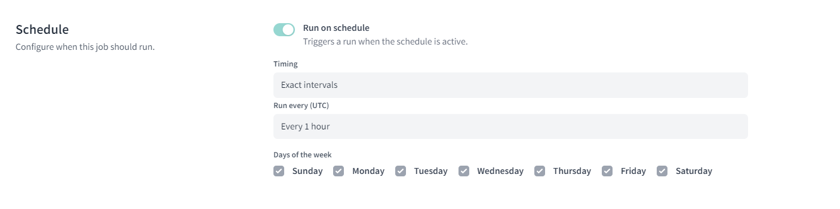
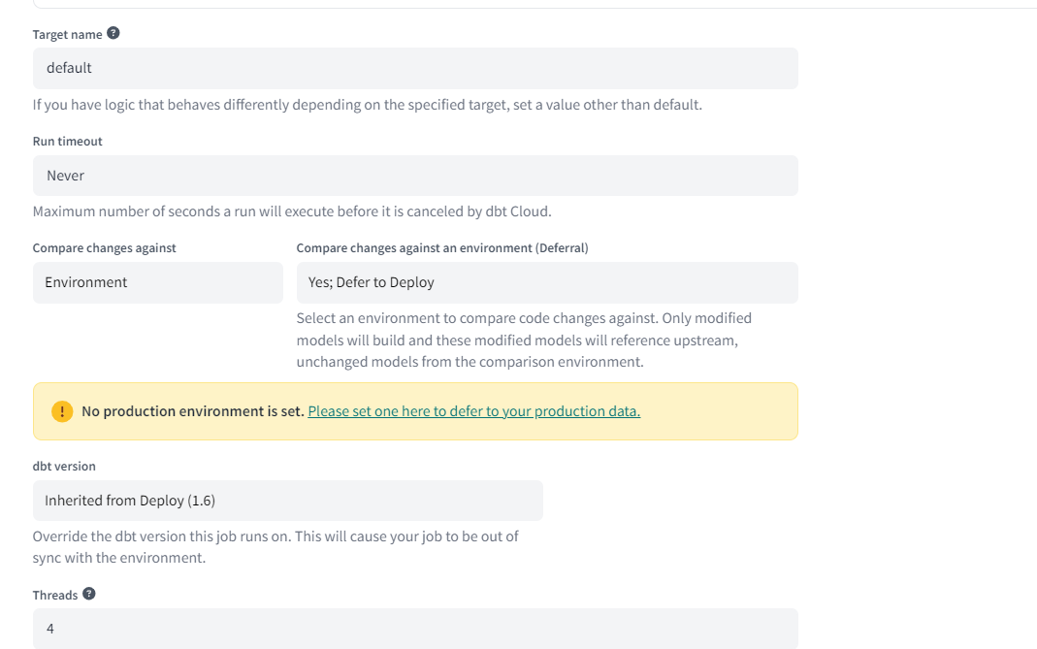
Deploy Job Settings

Slide 66
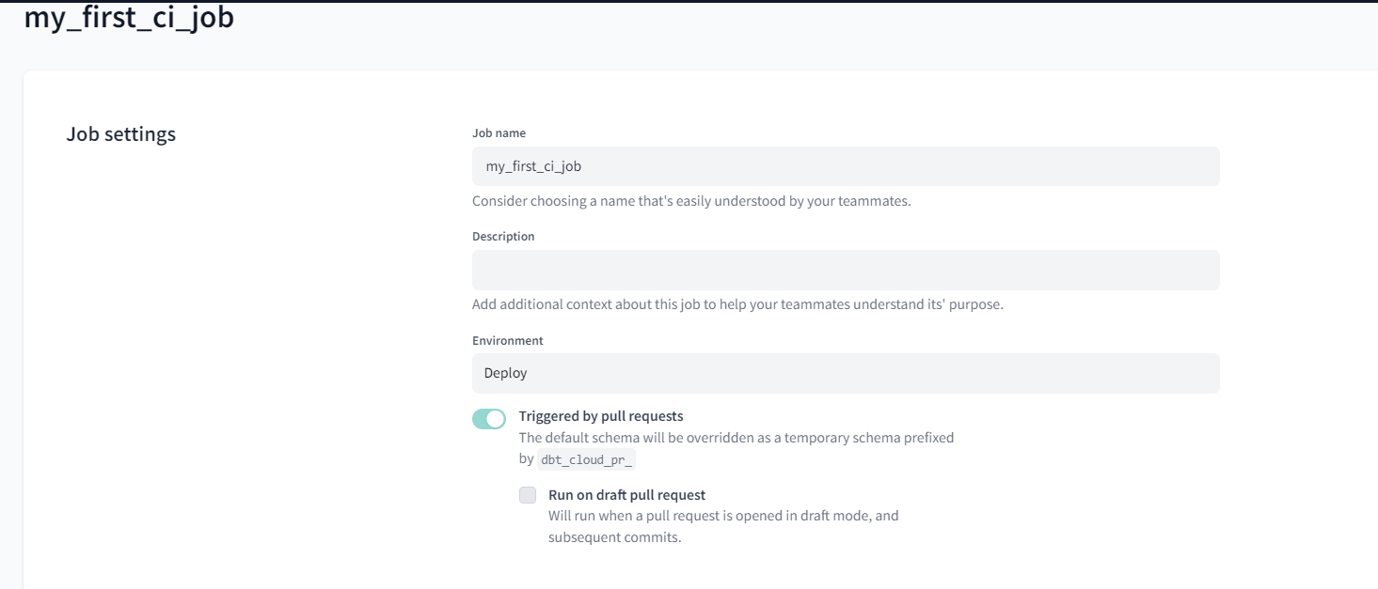
Deployment CI Settings

Slide 67
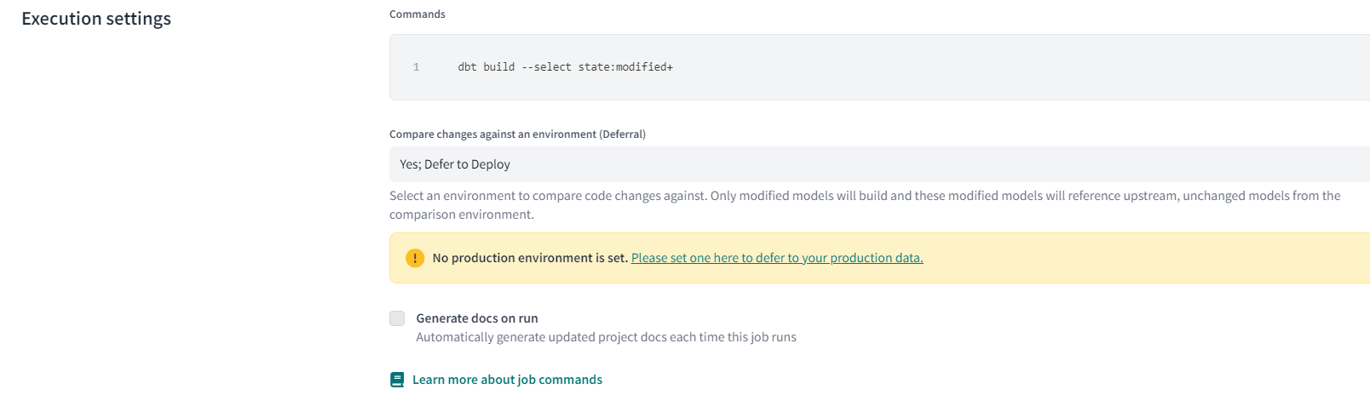
Deployment CI Jobs Settings

Slide 68
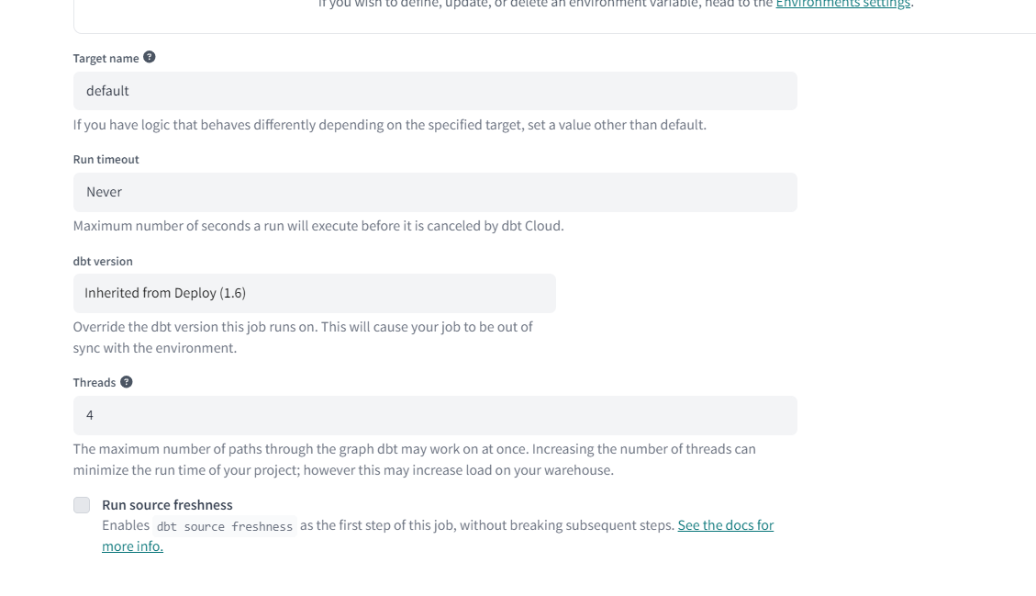
Deployment CI Jobs Settings

Slide 69
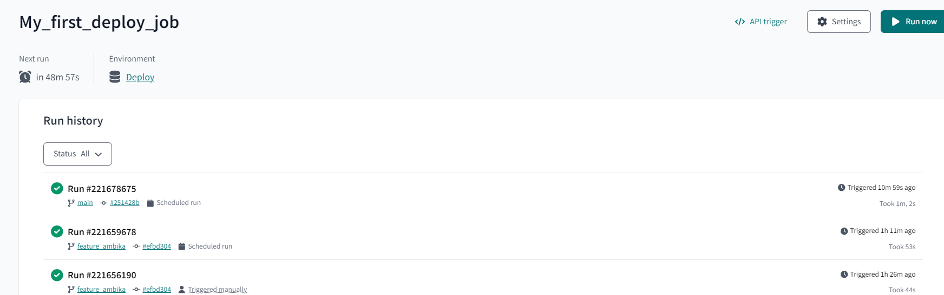
Deployment Jobs (Runs on schedule)

Slide 70
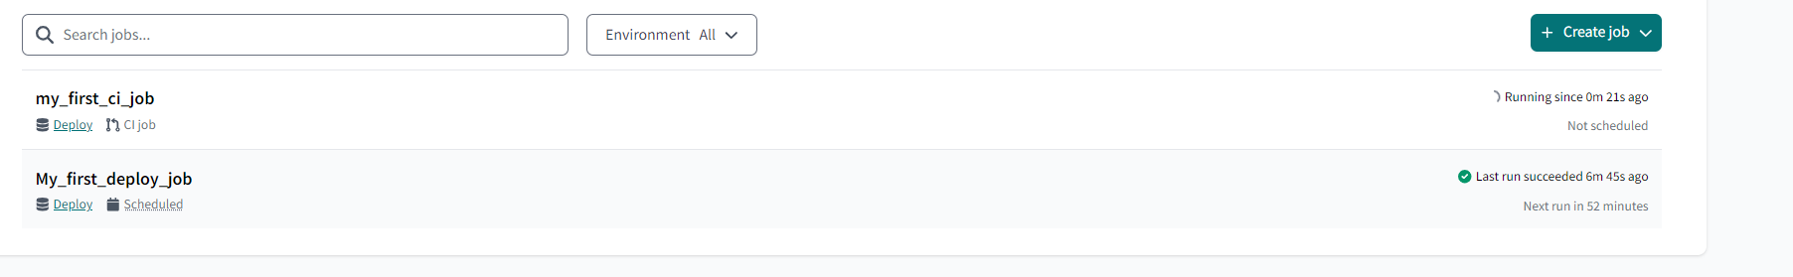
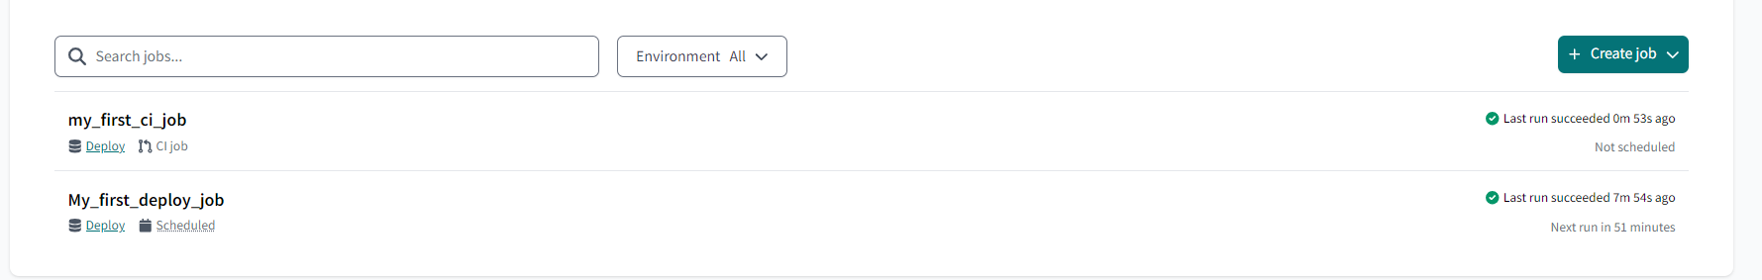
Deployment Slim CI Jobs (Runs on GitHub PR)

Slide 71
New concepts to teach
Dbt seed
Source freshness
Snapshot
Incremental
Update previous record to new time stmap and do above 3 steps
Change the value of merge_id anf update to new timestamp and follow above three steps
Dbt test –select –test_type:singular (accepting mor than one files)
Dbt build –s my_first_dbt_model(warn for >4) error/warn set in project.yml
Dbt test– store_failures (warn > 4) created in sepexrate schema set in dbt project.yml
Surrogate key in f\dimension model
Facts and dimension model
--vars
Tomorrow to add pre_hook and post_hook, on_run_start and on_un_end
Globa; varaiblrs, local ad env_varaibles

Slide 72
git init
git branch -M main
git add .
git commit -m "Create a dbt project"
git remote add origin https://github.com/<username>/dbt-sample-repository.git
git push -u origin main

Slide 73
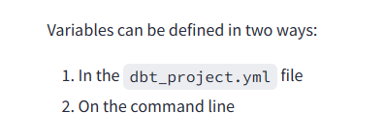
Doubts on variable
$ dbt run --vars '{"key": "value"}'

